Slide 1

Welcome to
DPRW

Slide 2
Title Author
Unit 2

Slide 3

Agenda
I. Objectives
II. Lead-in Activities
III. Lecture
  IV. Follow-up Activity

Slide 4

I. Objectives
After the class, you should be able to:
I Understand general functions and linguistic features of the title, and write one successfully
2 Understand general functions and linguistic features of the author /affiliation, and write them correctly
3 Understand general functions and linguistic features of the keywords, and select them properly

Slide 5
II. Lead-in Activities
Group discussion
What is the title of your selected paper?
Who is/are the author(s)?
What is the author’s affiliation?
How do the key words help you to read the paper?

Slide 6
III. Lecture
3.1 General Functions and Linguistic Features of the Title
3.2 General Functions and Linguistic Features or the Author / Affiliation
3.3 General Functions and Linguistic features of the Keywords

Slide 7
General Functions and Linguistic Features of the Title
General Functions
Summarizing the Main Text
Attracting the Reader
Facilitating the Retrieval (索引)
Linguistic Features
Using a Phrase Instead of a Sentence
Using More Nouns, Noun Phrases, and Gerunds
“Strategies for Writing and Publishing Academic Papers Successfully”

Slide 8
Writing Requirements
(1)To be brief and concise long enough to describe the content of the paper. 8 to12 words on average (no more than 20 words)
“On the Addition to the Method of Microscopic Research by a New Way of Producing Color-contrast Between an Object and Its Background or Between Definite Parts of the Object Itself.” (difficult for readers to catch its meaning and remember it and
corrected into “A New Way of Producing Color-contrast in Microscopic Examination” )
Use a subtitle
“ International Communication Pragmatics—A New Branch of Language Studies.”
Not advisable to use such decorative expressions in the title
“On the…, “Regarding…; “Investigation on…” “The Method of…,” “Some Thoughts on…; “Research of…; etc. (lead to redundancy)

Slide 9
Writing Requirements
(2) Be Specific by using subtitles or prepositional phrases indicating the research scope
Computer Control (vague and empty)
Computer Control: Software Safeguards and
Computer Theft
Software Safeguards and Computer Theft in
Computer Control
The Impact of Alcoholism Abuse on Female Health
The Impact of Alcoholism Abuse on Female
Students’ Health in NEU

Slide 10
Writing Requirements
(3) Avoid Questions
If your title really has the meaning of a question, you may adopt the form of question word + infinitives. “Essential Steps for Writing a Title Page: How to Prepare the Title, Authors / Affiliations, and Keywords.”
(4) Be Unified in parallel parts of a title
“The Design and Preparing of Si3N4”
“The Design and Preparation of Si3N4”

Slide 11
Writing Requirements
(5) Be Standard
The abbreviations, symbols, and any academic terms in a title should be widely accepted in the field. The writer should follow the specific requirements set forth by the journal to which your paper is to be submitted.
For example, we may prepare a title in three ways as below.
1)LEARNING FOREIGN LANGUAGES AND TEACHING CULTURAL BACKGROUND
2) Learning foreign languages and teaching cultural background
3) Learning Foreign Languages and Teaching Cultural Background

Slide 12
Practice on titles (1)
With the above discussion in mind, let us analyze the following titles and try to correct them.
Nitrendipine Is Effective in Severe Hypertension
Reduction of Motion Artifacts Using a Two-frequency Impedance Plethysmograph and Adaptive Filtering
Effects of Acute Changes in Canine LV-Chamber Volume and Shape on Accuracy of Impedance Catheter Estimates of LV-Chamber Volume

Slide 13
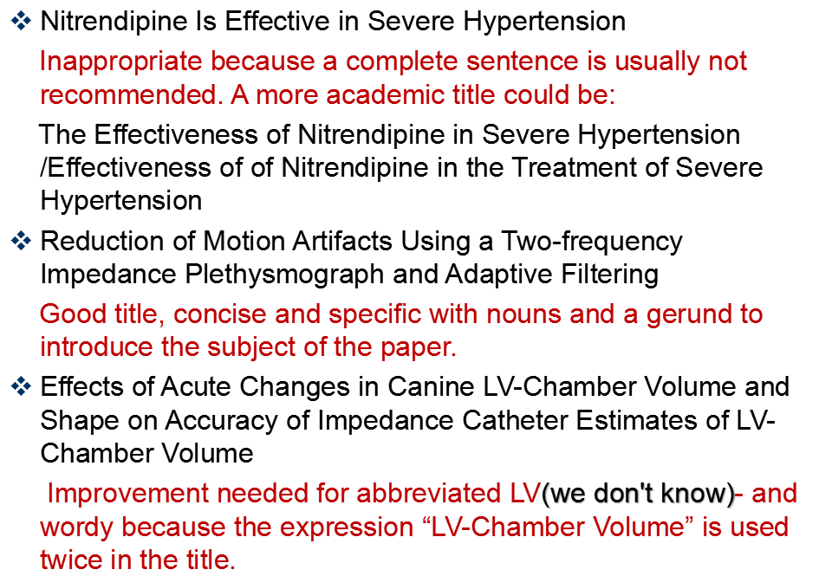
Practice on titles (1) with answer

Slide 14
Practice on titles (2)
With the above discussion in mind, let us analyze the following titles and try to correct them.
1) On Developing the Internet and the Spread of Culture and Information
2) Innovation and the Materials Revolution
3) Inputting Cross-cultural Information for More Effective English Teaching by Means of Inputting in General College English Teaching
4) Phase Equilibria Between Fluorothene and Organic Solvents
5) Can the Rate of Wash Load Be Predicted from the Bed Load Function?

Slide 15
Practice on titles (2) with answer
With the above discussion in mind, let us analyze the following titles and try to correct them.
1) The Development of the Internet and the Spread of Culture and Information
2) Innovation and the Revolution of Materials in ...
3) Inputting Cross-cultural Information for More Effective English Teaching by Means of Inputting in General College English Teaching
4) Phase Equilibria Between Fluorothene and Organic Solvents
5) The Rate of Wash Load Be Predicted from the Bed Load Function

Slide 16
General Functions and Linguistic Features or the Author / Affiliation
General Functions
(1) Bearing Author’s Responsibility
(2) Facilitating Retrieval and Correspondence
(3) Heightening Academic Level
Linguistic Features
According to the Basic Rules of the Chinese Phonetic Alphabet Orthography that came into effect on October l, 2012, the family name shall be put before the given name and the first letters of both names should be capitalized.
刘惠宁in passport: Liu Huining; Liu, Huining; LIU Huining;
刘惠宁in visa: Huining LIU; Huining Liu;
刘惠宁in journal based on specific requirements

Slide 17
Writing Requirements
(1) Format
according to the specific requirements of the journal.
(2) Number of Authors
No more than five. “et al.” (meaning “and others”) after the principal authors or use notes to show the names of the other authors.
(3) Author’s Title Omitted
“Professor; “President” omitted before the name of an author. If an academic title must be included, it can be put together with the affiliation.
XIN Qinghua
Professor, Department of Foreign Languages and Literatures, Tsinghua University
Beijing 100084, the People’s Republic of CHina

Slide 18
Writing Requirements
(4) Address
The institutional affiliation should be written from the smaller units to the larger ones, just as the address information. Attention should be paid to the postal code, because its position in the address varies from country to country. For instance, the American zip code is usually put after the abbreviation of the state, while the British postal code appears after the city / town name. For example:
Mr. Harry Martinez Gillian Jones LI Xiaohua
Foster Labs,Inc James Brown & Sons Art School
Andersom Blvd 44-50 London Road NEU
St. Charles, IL 6013 Brighton Heping, Shenyang
USA BNS 9KL 110004
UK P.R. China

Slide 19
General Functions and Linguistic features of the Keywords
General Functions
(1) Easiness of Highlighting
(2) Easiness of Retrieval
Linguistic Features
(1) More Nouns
Investigation “fabrication;” “education”
(2) Limited Numbers
Four to six keywords are the average. In general, there should be at least two and at most eight.

Slide 20
Writing Requirements
(1) Using the Required Section Title
“keywords,” is also variously called “Keywords Index”; “Keywords and Phrases; “Indexing Terms” etc.
(2) Placing the Section Correctly
Though keywords can be either above or below the abstract of a paper, they are, in most cases, placed below the abstract.
(3) Spacing the Keywords
Keywords: individual difference (ID), factors, English, learning proficiency
Keywords: individual difference (ID); factors; English; learning proficiency
Keywords: individual difference (ID) factors English learning proficiency
(4) Adopting Standard Abbreviations

Slide 21
Work in pairs and comment on the following keywords.
Keywords: English, vocabulary, tendency.
Keywords: Collocation Context Connotation
Keywords: mass media
Keywords: nuclear waste, nuclear fuel cycle, remediation, bioremediation, citrobacter, hatetheavy metal accumulation, uranium transuranic elements, technetium
Keywords: employee management; financial crisis; abusive supervision; justice; misbehavior

Slide 22
IV. Follow-up Activity
Search for three papers in journals of your field to analyze their titles, authors, affiliations as well as keywords according to what you have learned in the unit.
Give your own paper a title, author, affiliation and keywords

Slide 23
Thank You !

